Slide 1
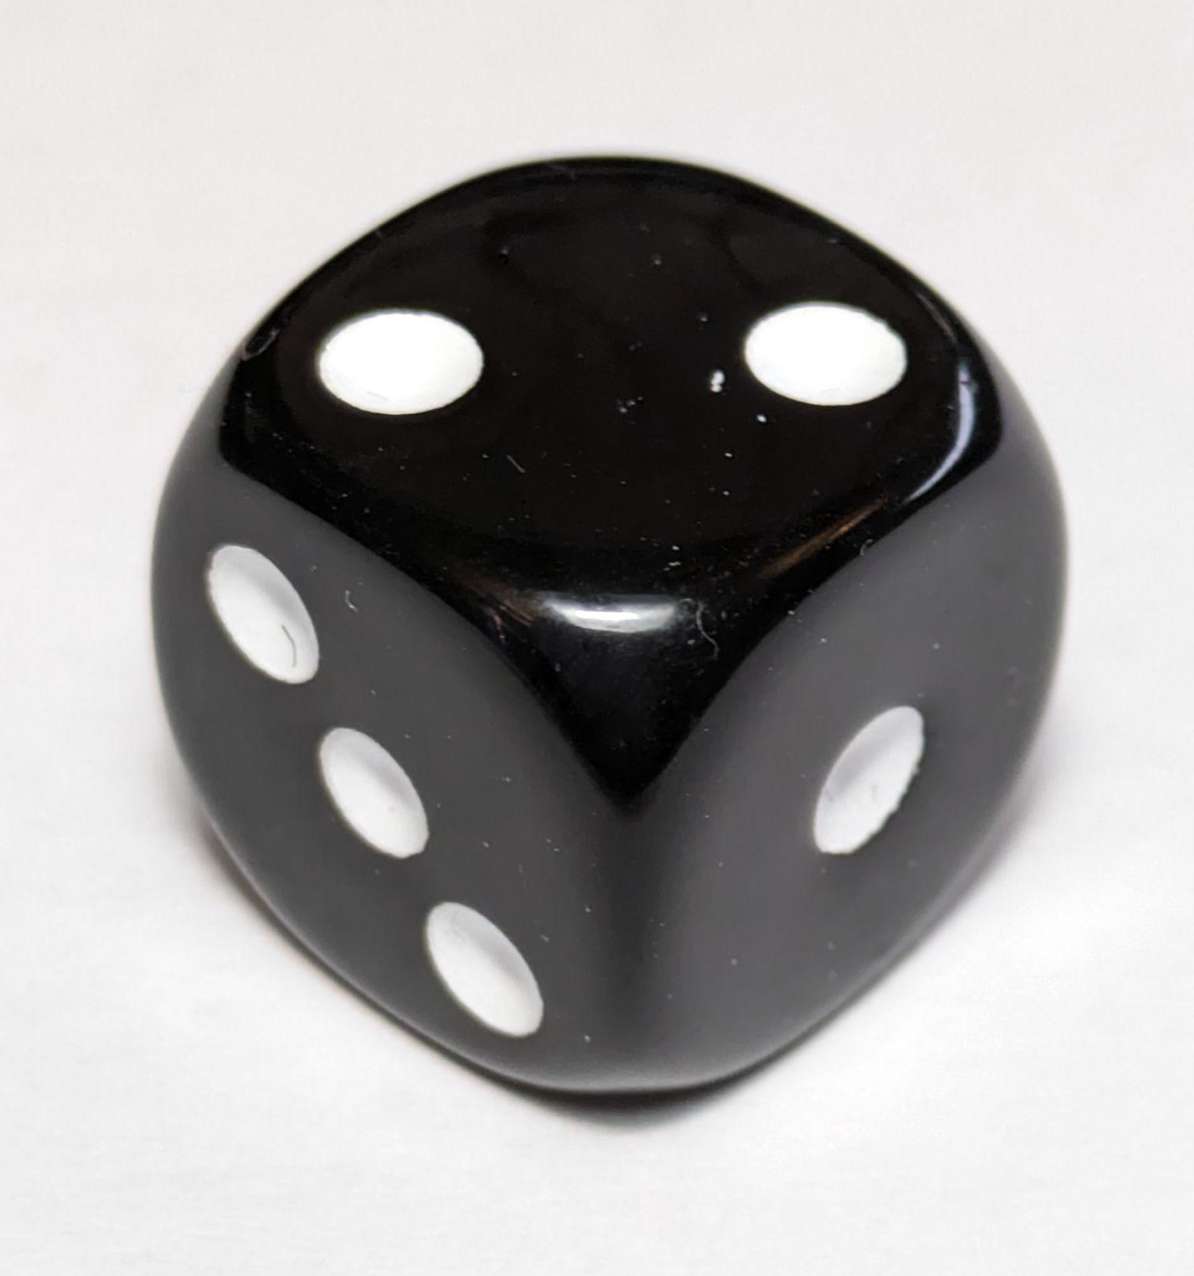


Non-equally likely outcomes
Task A: Identifying which outcome is more likely to happen
1) For each scenario, tick the outcome or event that is most likely to happen.
a) rolling a regular six-sided dice
b) spinning the spinner
8
1
rolling a multiple of 2 or rolling a multiple of 3
7
2
lands on a factor of 8 or lands on a factor of 12
6
5
4
3
c) picking a counter from the bag
d) choosing a letter at random from the word MATHEMATICS
B
A
picking A or picking B
choosing a vowel or choosing a consonant
B
A
B
A
B
2) Starting with the least likely, sort the spinners in order of their likelihood of landing on ‘win’.
A
B
C
D
win
win
win
win
lose
lose
lose
win
win
lose
lose
lose
E
F
win
G
win
lose
win
win
lose
win
lose
win
win
lose
win
lose
win
lose
lose
win
win
win
D, B, A, E, G, C, F

Slide 2
Non-equally likely outcomes
Task B: Recognising non-equally likely outcomes in context
1) For each context, tick the outcome that seems most likely to happen.
context | outcome A | outcome B
a day in July in the UK | frost | heatwave
a day in December in the UK | frost | heatwave
a day in December in Australia | frost | heatwave
a drink stall in the UK in December | most customers buy iced smoothies | most customers buy hot chocolates
a professional darts player in a running racing against a professional sprinter | professional darts player wins | professional sprinter wins
a professional darts player in a darts match against a professional sprinter | professional darts player wins | professional sprinter wins
2) For each scenario, write down a contextual factor which might affect the likelihood of the outcomes.
a) Sam and Alex are playing each other in a chess match. ξ = {Sam wins, Alex wins}
The experience of each player at playing chess.
b) Laura is predicting whether it will snow on a particular day. ξ = {snow, no snow}
Time of the year, location, the weather on the days leading up to it.
c) Jun is buying an ice cream and choosing a flavour. ξ = {vanilla, strawberry, mint, chocolate}
Which flavours Jun prefers.
Mathematics in Education and Industry
v2.3

